Slide 1
Prediction of Thermal Conductivity of 2D woven composites using Mechanics of Structure Genome (MSG) and Artificial Neural Network (ANN)

Slide 2
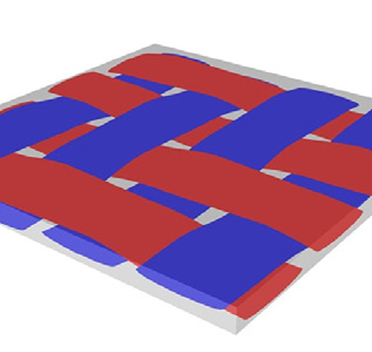
What are Woven composites and why use them ?
Woven composites are a type of fiber-reinforced composite material where the reinforcing fibers are woven together in a fabric-like structure before being embedded in a matrix (usually a polymer resin like epoxy)
Woven composites are extensively utilized in various structures—including fuselage frames, electronic devices, and medical implants—due to their outstanding mechanical properties and cost-effective manufacturing.
The tailorable weave patterns associated with woven composites provide great design freedom to enhance the mechanical & thermal performance of woven composite structures.

Slide 3
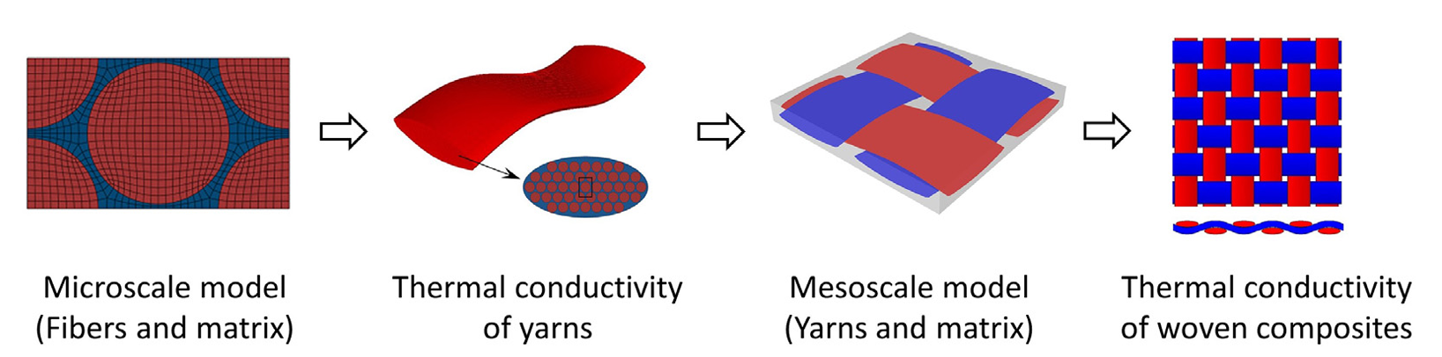
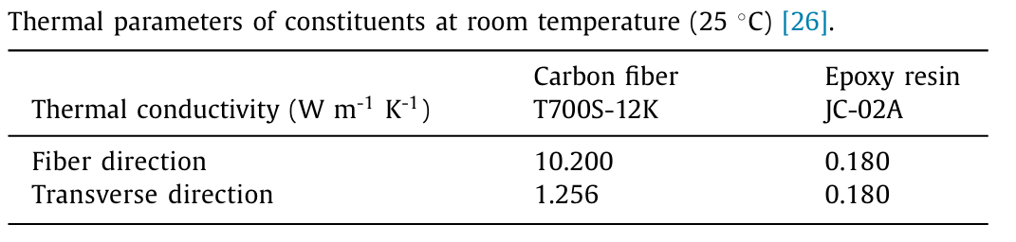
Two Step Homogenization process
The Multiscale modelling is done with a 2-step homogenization process
Homogenization 1
Homogenization 2

Slide 4
Project Workflow
Re-implementation of code from paper
New feature addition to enable natural language inputs
Input Data and Label Generation
Deploying the Artificial Neural Network (ANN) model as a web API and hosting it online
Artificial Neural Network Modelling, Training and Testing
Develop a custom GPT model using ChatGPT’s API with function calling capabilities to enable natural language-driven simulations
Correlation with existing results by validating outcomes against those reported in the selected paper.
Note : This NLP implementation is not part of the original paper and is a feature addition

Slide 5
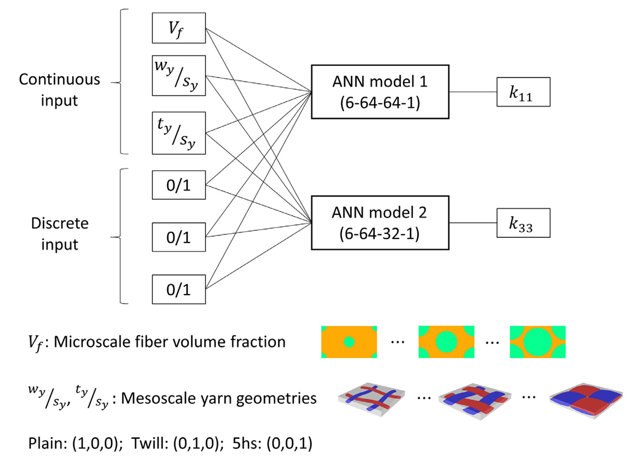
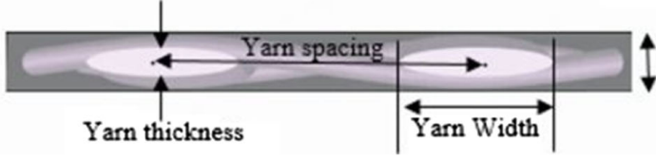
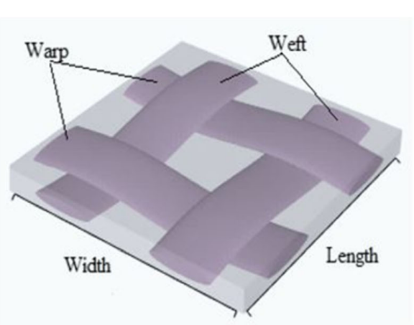
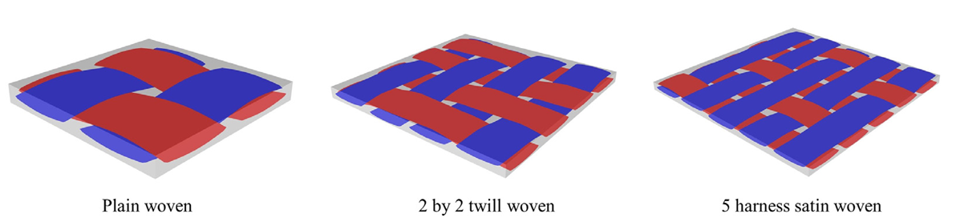
ANN architecture
W_{y} / S_{y} – Ratio of Yarn Width to Spacing
T_{y} / S_{y} - Ratio of Yarn thickness to Spacing

Slide 6
Input Data Generation
TexGen Input file
Final conductivity of composite
(k11 and k33)
Fiber Volume fraction (Vf)
Yarn conductivity
(k11 and k33)
TexGen
(Textile geometry modeller)
.geo file
Swiftcomp
(Homogenization software)
Swiftcomp
(Homogenization software)
GMSH
(Meshing software)
.inp file
.ori file
.msh file
.sc file
(Micro)
.sc file
(Meso)
Fiber conductivity
Matrix conductivity

Slide 7
Note on Input data generation
To generate the input data the following steps must be followed. The dependencies are required for the following tasks
2D geometry creation : GMSH
Textile Fabric Modelling : TexGen
MSG based Multiscale Homogenization : Swiftcomp
Steps :
Use Latin Hypercube Sampling (LHS) to create input data for the following inputs –
Fiber Volume Fraction
Yarn Width to Spacing Ratio
Yarn Thickness to Spacing Ratio
Download and install GMSH from https://gmsh.info/ (Opensource)
Swiftcomp is not an opensource software. It can be requested from Analyswift.
https://analyswift.com/swiftcomp-vamuch-micromechanics-modeling-of-heterogeneous-materials-2/
Download and install TexGen from Sourceforge - https://sourceforge.net/projects/texgen/
Note : There are 24000 data points to be generated. The estimated time would be 3-4 days or more depending on the PC configuration (due to multiple function calls)
The ANN model can be tested without any of these dependencies. This is just for input data and label generation.
The working of this code is demonstrated in the video

Slide 8
Thank You

